Slide 1
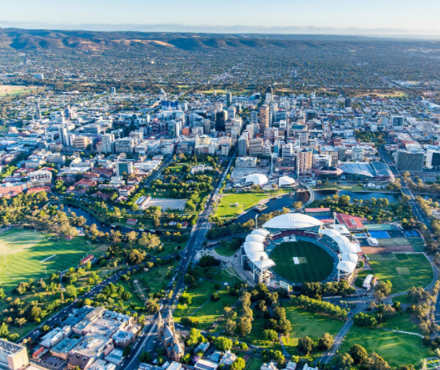

Strata & Community Title: a Basic Guide
Strata Title Corporations, Community Title Corporations & Community Strata Title Corporations
Presented by Diana Thomas
Community Justice Services SA

Slide 2
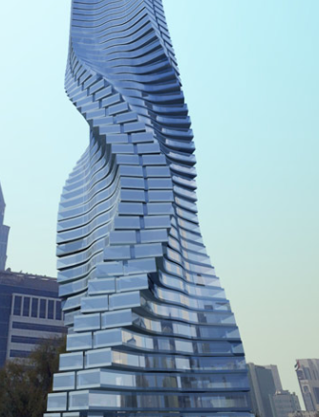
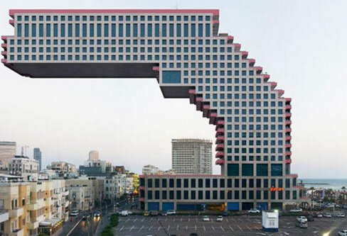
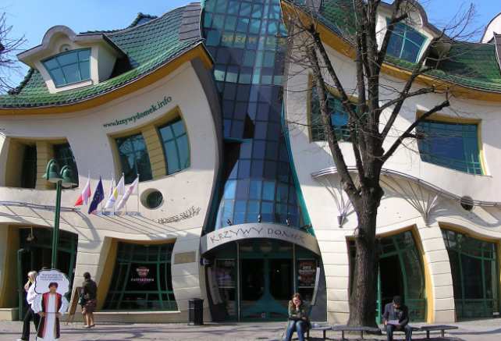
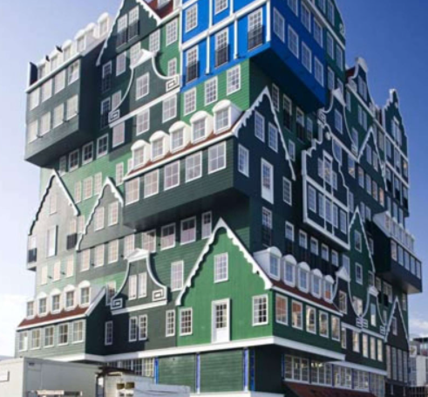
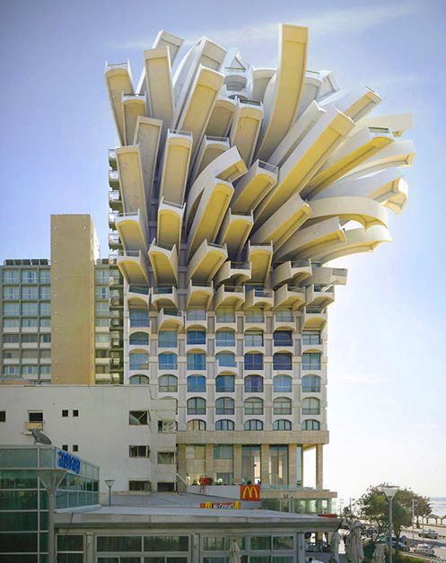


Strata Titles Act 1988
Strata Titles Regulations 2018
Community Titles Act 1996
Community Titles Regulations 2011

Slide 3
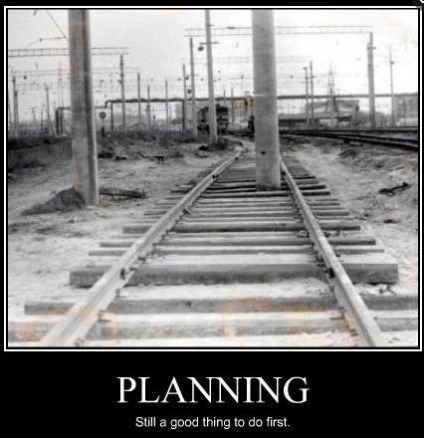
The plan for
the next 60 minutes

Slide 4
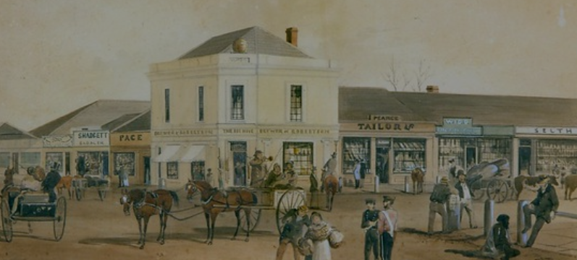
Moiety &
Corporations Titles

Slide 5
Moiety & Corporations Titles
Moiety Titles
In a moiety title, sometimes referred to as a cross lease, the ownership of a unit comes from being the registered owner of a share of the land the group of units sits on. The owner is leasing the right to occupy their unit, along with the right to use common areas, from the other unit owners.
Company Titles
A company is registered on the certificate of title as the sole owner of the land a group of units sits on. Owners are issued with a share certificate in the company. Each unit owner has the exclusive right to occupy their unit & have the right to use common areas. When a unit is sold the share certificate is transferred to the buyer.
Converting Company Titles & Moiety Titles
Most company & moiety titles can be converted into either a community title or a Torrens title. This can make the administration simpler and may increase the value of the property.

Slide 6

Strata Title Corporations

Slide 7
What is a
Strata Title?
Strata Titles can be:
Town Houses / homettes/ commercial spaces such as shops / warehouses/ apartments.
The Strata Plan divides the building and the associated land into units and common areas.

Slide 8


Slide 9
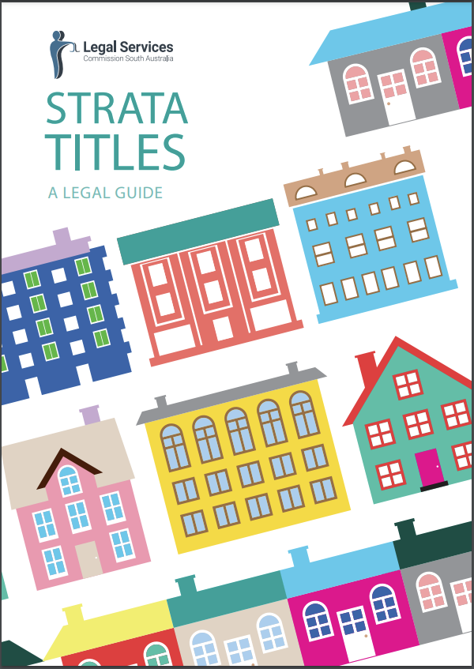

Slide 10

Common property = everything else
The common property comprises:
any land or space that is not within a unit;
any pipe, cable, wire, duct or drain that is not for the exclusive use of a unit;
any structure that is not for the exclusive use of a unit installed before the deposit of the strata plan;
any structure installed by a strata corporation as part of the common property;
any other structure on the site committed to the care of a strata corporation as part of the common property.

Slide 11
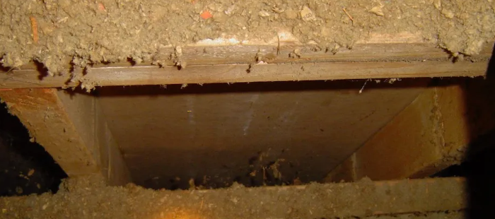

Slide 12
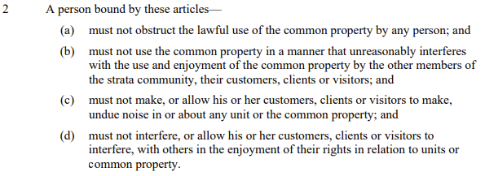

Slide 13
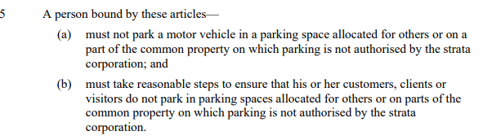

Slide 14
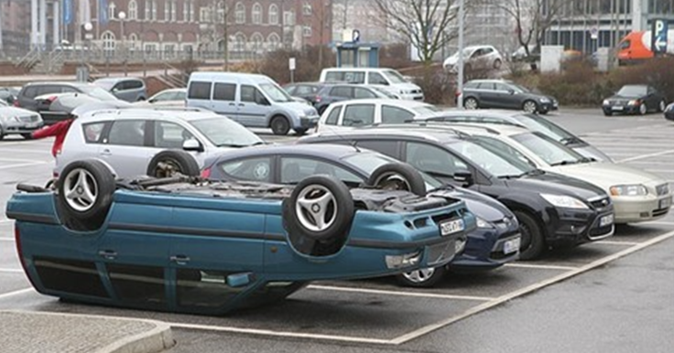

Slide 15
A person bound by these articles—
must not park a motor vehicle in a parking space allocated for others or on a part of the common property on which parking is not authorised by the strata corporation; and
must take reasonable steps to ensure that his or her customers, clients or visitors do not park in parking spaces allocated for others or on parts of the common property on which parking is not authorised by the strata corporation.
How do you
Interpret
Schedule 3,
clause 5:

Slide 16


Slide 17


Slide 18
Its all about POWER!

Slide 19
Cases
Byczko v Strata Corp 6222 Inc [2022] SADC 32BC202201899
HG Royal Park Pty Ltd v Strata Corp 7176 Inc[2007] SASC 348BC200708250
Wamije Investments Pty Ltd v Strata Corp 1232 Inc
[2021] SADC 4BC202106229

Slide 20
Community Title
Community Titles Act 1996
Community Title Regulations 2011
Major revision of the Act 2013

Slide 21


Slide 22
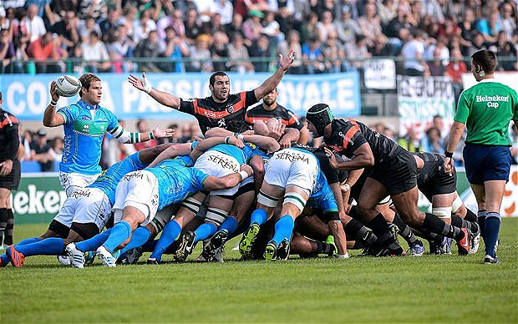

Slide 23


Slide 24


Slide 25


Slide 26


Slide 27
One lot on top of another lot = Community Strata

Slide 28
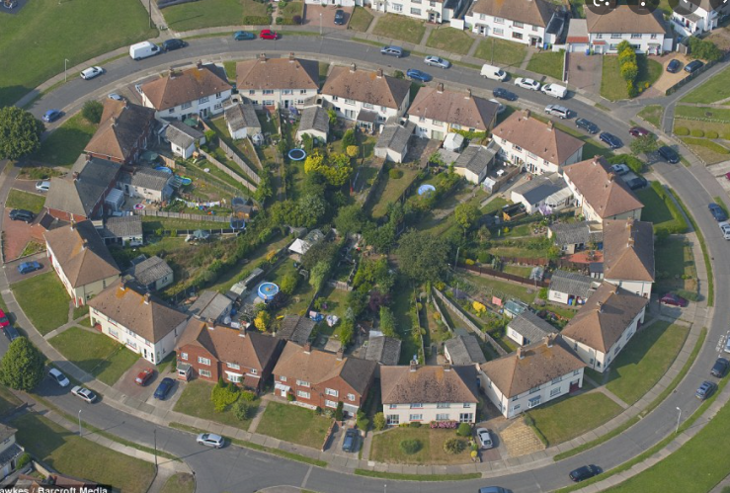
Lots side by side = Community Title

Slide 29
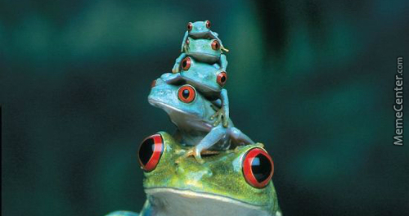

Slide 30
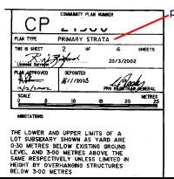
Its not that scary…. take a look at the Title Deed

Slide 31


Slide 32
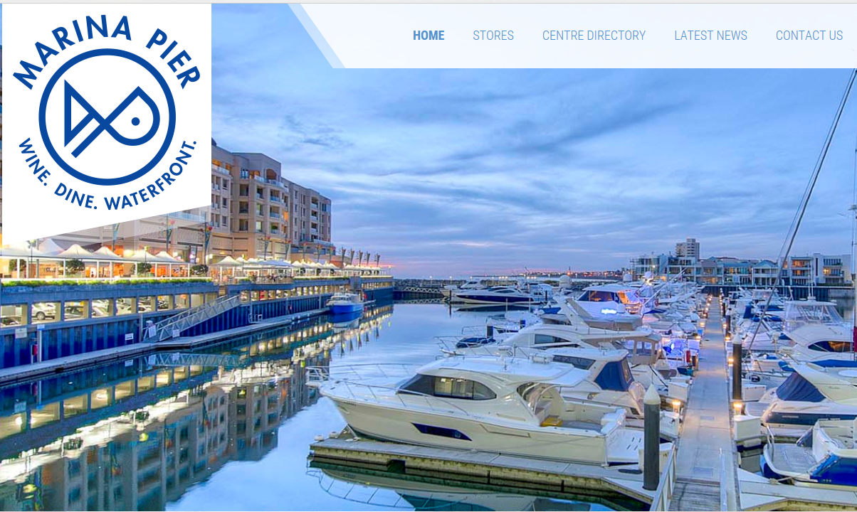

Slide 33
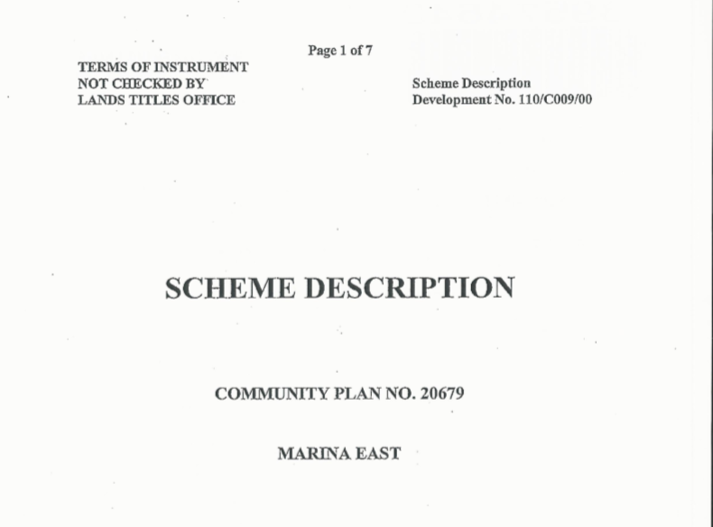

Slide 34
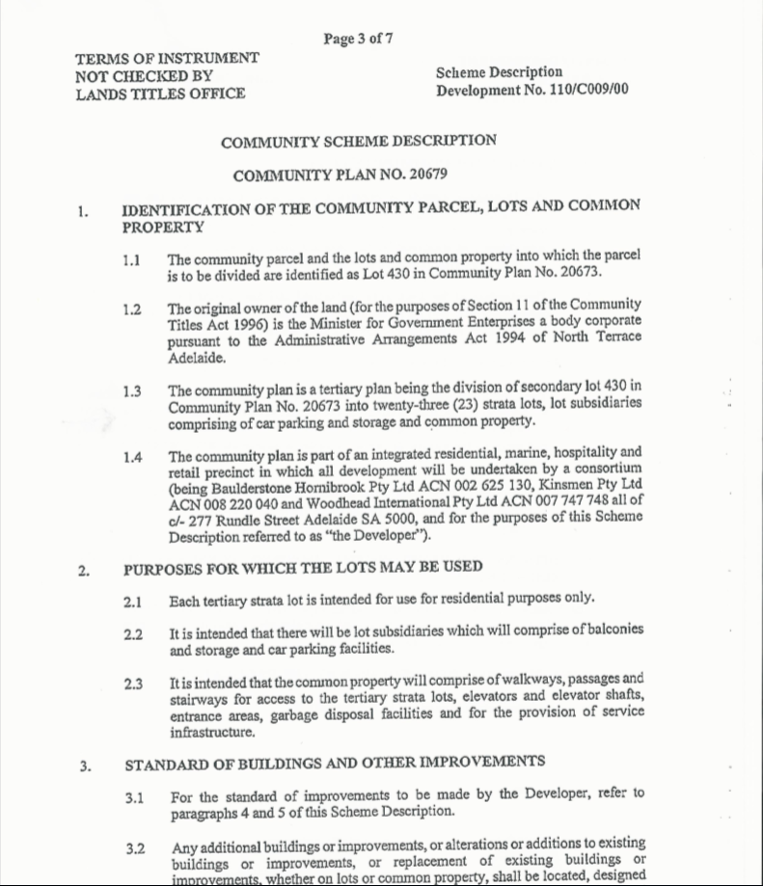

Slide 35
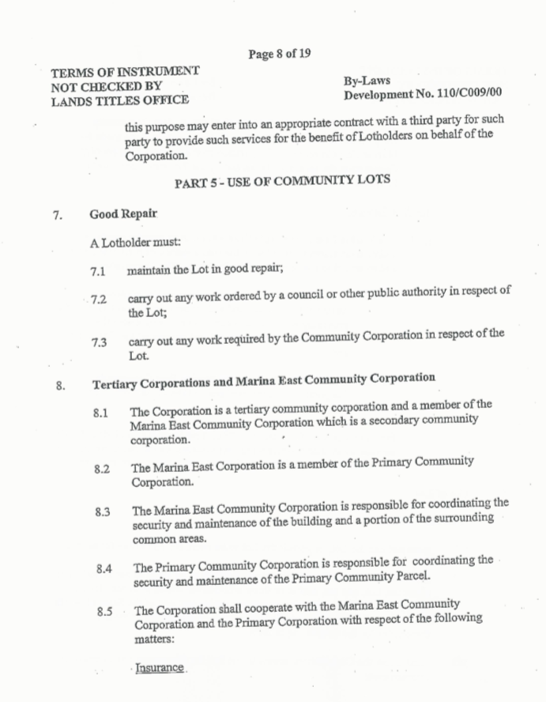

Slide 36


Slide 37
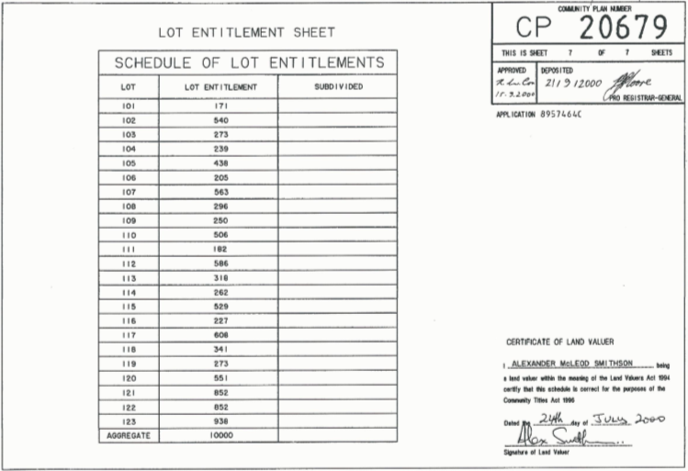

Slide 38

Insurance

Slide 39


Slide 40
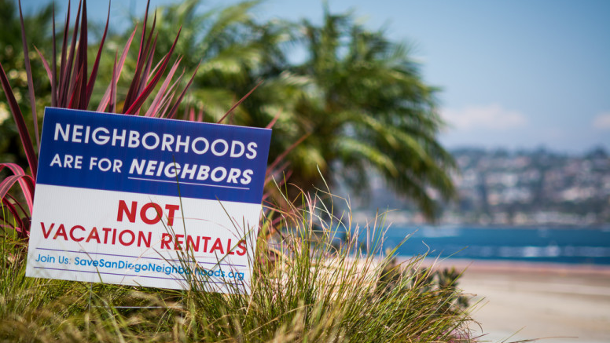

Slide 41
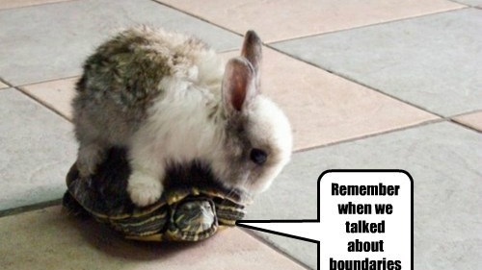

Slide 42
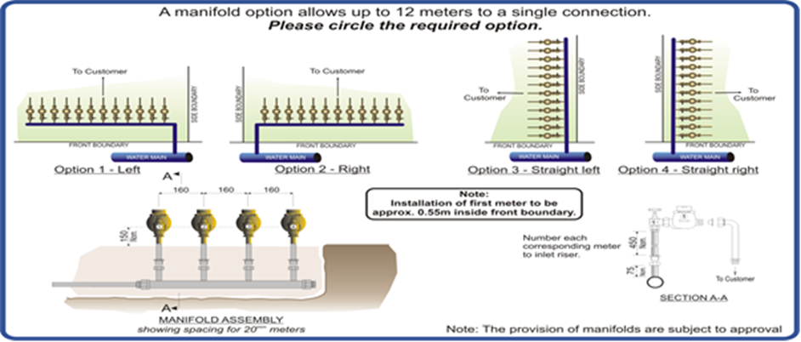

Slide 43
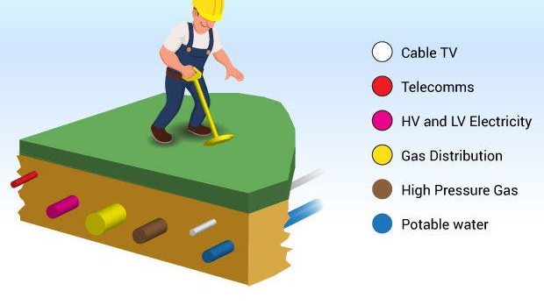

Slide 44
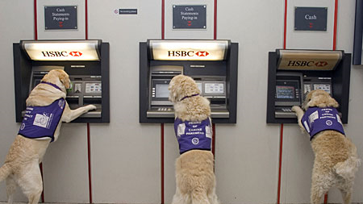
Assistance Animals

Slide 45
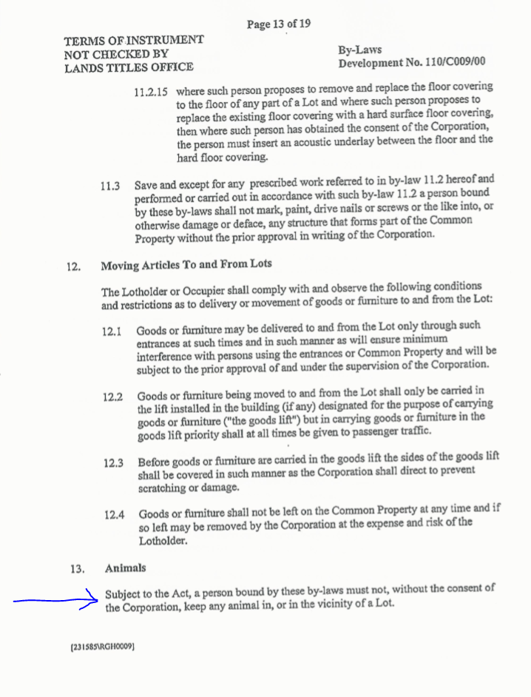

Slide 46
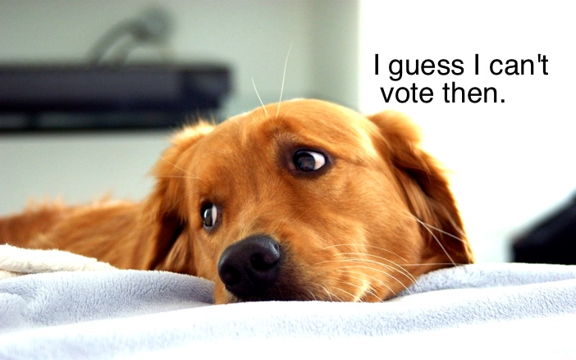

Slide 47


Slide 48
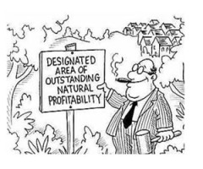

Slide 49


Slide 50
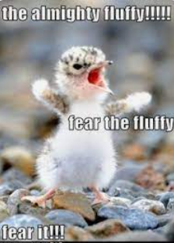

Slide 51
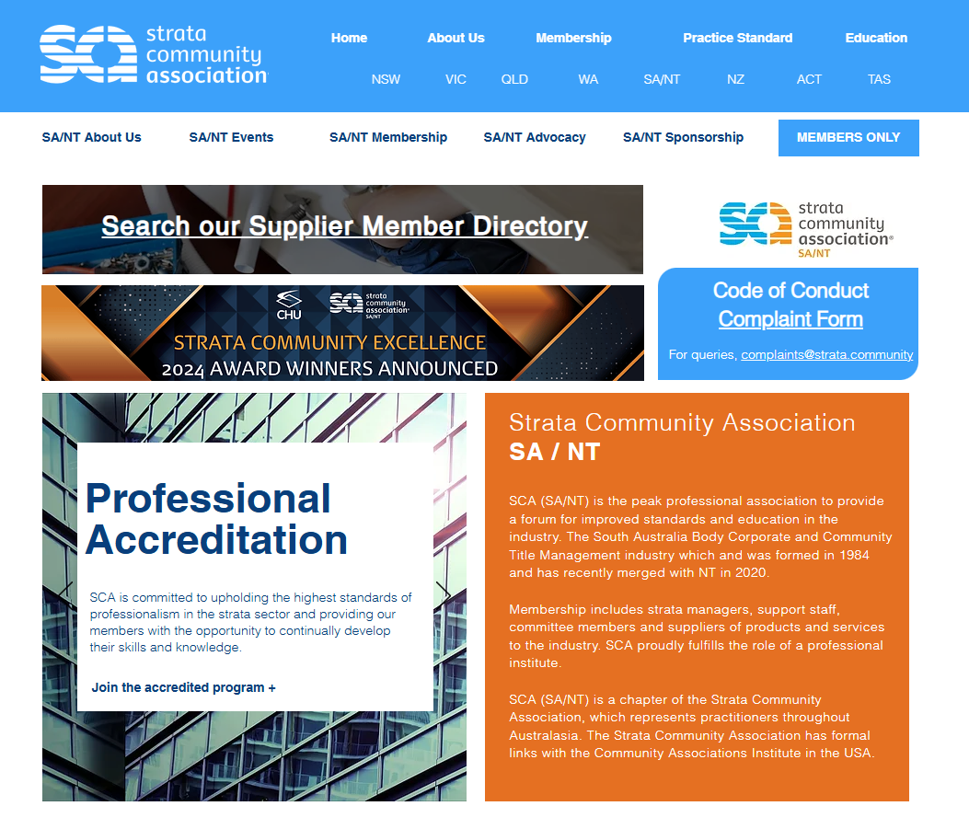

Slide 54
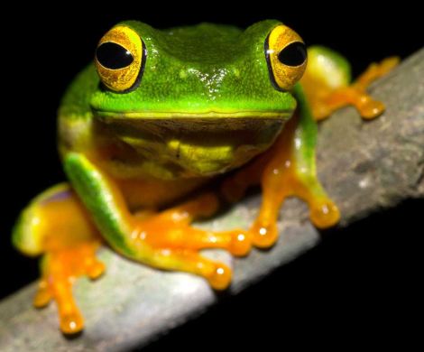
Thanks for listening!
Questions?

Slide 55
0 - 2 lots (or buildings and improvements on the common property insured for less than $100 000) =
The by-laws of a scheme consisting of two lots may exempt the corporation from the requirements to:
Hold annual general meetings (except the first general meeting)
Prepare accounting records of the corporation’s receipts and expenditure and to prepare an annual statement of accounts
Have the annual statement of accounts audited
Establish administrative and sinking funds
Maintain a register of the names of the owners of the community lots.
When there are only 2 lots, both owners must agree to achieve a special resolution.

Slide 56
3 lots =
By laws may only exempt the corporation from the requirement to maintain a register of names of the owners of the community lots.
When there are three community lots and the owner of each lot is entitled to one vote, a special resolution is achieved if the resolution is passed at a properly convened meeting of the corporation at which either no vote, or only one vote, is cast against the resolution.

Slide 57
4 + Lots =
When there are four or more community lots, a special resolution is achieved if the resolution is passed at a properly convened meeting of the Community corporation and the number of votes (if any) cast against the resolution is 25% or less of the total number of votes that could be cast at a meeting at which all lot owners are present and entitled to vote.

Slide 58
0 – 6 lots =
If there are 6 or less lots (or buildings and improvements on the common property insured for less than $100 000) = no requirement to present a forward budget as part of expenditure statement at AGM
If the community scheme consists only of lots used for residential purposes AND there are not more than 6 community lots AND the community corporation, by unanimous resolution, resolves not to have the statement of accounts for that financial year audited.

Slide 59
0 – 10 lots =
1 person may hold 2 or all of the positions of presiding officer, secretary and treasurer
11+ lots =
One person may hold up to 2 of these positions s 76(3)
7 – 20 lots =
With improvements on the common property insured for $100 000 or more, a forward budget must be presented at each annual general meeting, as part of the expenditure statement. The forward budget must include proposed expenditure (other than recurrent expenditure) for a three year period.
New information must be presented about proposed non recurrent expenditure every 3 years

Slide 60
21 + lots =
For corporations with more than twenty units, and with improvements on the common property insured for $100 000 or more, the forward budget presented at each annual general meeting must include proposed expenditure (other than recurrent expenditure) for a five year period.
New information must be presented about proposed non-recurrent expenditure every five years.

